Slide 1
Presentation Slides for
Project 2 Part 3
Part-Time Data Science
Airline Safety Data
By Vj Esguerra
Due: 9/19/21

Slide 2
Agenda
Overview
Data Cleaning
Exploratory Visuals

Slide 3
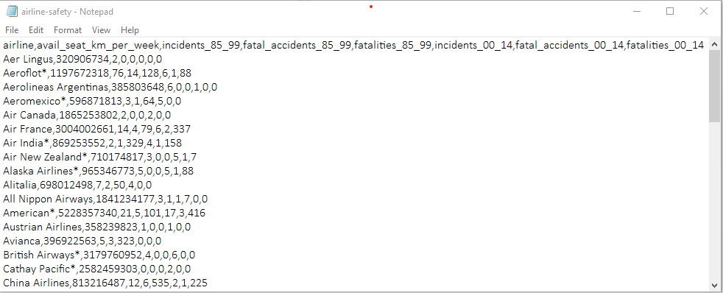
Overview
Data used in this project are from the airline safety dataset located here: https://github.com/fivethirtyeight/data/tree/master/airline-safety

Slide 4

Overview
The dataset was originally used for the story “Should Travelers Avoid Flying Airlines That Have Had Crashes in the Past?” located here:
http://fivethirtyeight.com/features/should-travelers-avoid-flying-airlines-that-have-had-crashes-in-the-past/

Slide 5
Overview
The data identified by dictionary below was cleaned and explored to find any possible relationships, trends, etc.
Variable Name | Description
airline | Airline (asterisk indicates that regional subsidiaries are included)
avail_seat_km_per_week | Available seat kilometers flown every week
incidents_85_99 | Total number of incidents, 1985–1999
fatal_accidents_85_99 | Total number of fatal accidents, 1985–1999
fatalities_85_99 | Total number of fatalities, 1985–1999
incidents_00_14 | Total number of incidents, 2000–2014
fatal_accidents_00_14 | Total number of fatal accidents, 2000–2014
fatalities_00_14 | Total number of fatalities, 2000–2014

Slide 6
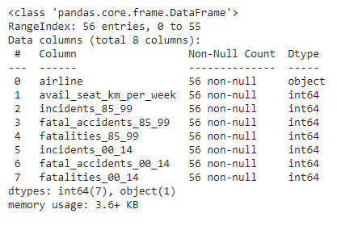
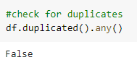
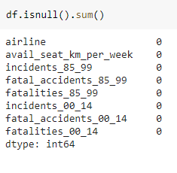
Data Cleaning
The dataset was very clean to begin with:
Data types were appropriate for each column (object for airline, the rest were int64).
There were no duplicates.
No null values were present in the dataset.

Slide 7
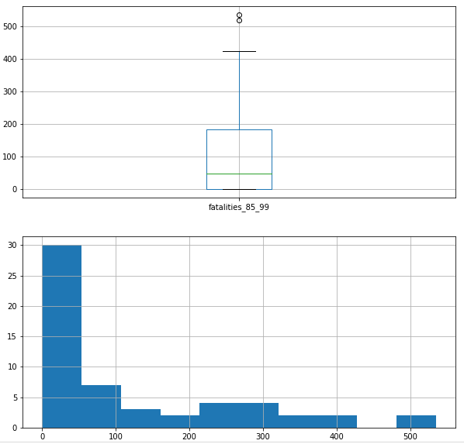
Exploratory Visuals
Several boxplots and histograms were created to visualize the numerical data:
Boxplots aided in the identification of outliers as well as the distribution of the data.
Histograms provided a count of the occurrence of each data value which helped in discerning trends.
The following were learned using the above visualizations with the data’s descriptive statistics:
Each numerical column had outliers.
More incidents (mean and max¹), fatal accidents (mean and max²), fatalities (mean only³) in the earlier time period 1985-99.
¹incidents_85_99 vs incidents_00_14: mean 7 vs mean 4, max 76 vs max 24
²fatal_accidents_85_99 vs fatal_accidents_00_14: mean 2 vs mean 1, max 14 vs max 3
³fatalities_85_99 vs fatalities_00_14: mean 112 vs mean 56, max 535 vs max 537

Slide 8
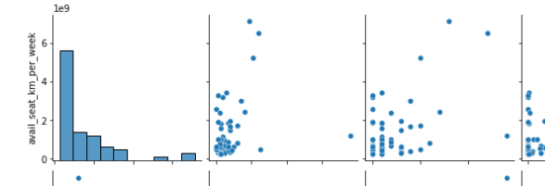
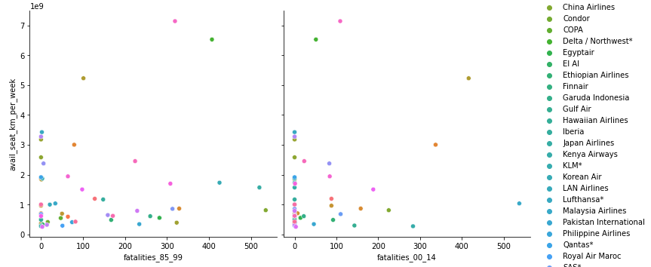
Exploratory Visuals
Pairplots and scatterplots were created to visualize the numerical data:
Pairplot of the entire dataframe gave a “big picture” view of the data.
Incidents, fatal accidents, and fatalities seem to cluster within the range between greater than zero and 4 billion for avail_seat_km_per_week.
Scatterplots between each of the features and the target provided a way to see whether there were patterns.
Because of 56 different airlines listed, hues couldn’t isolate a specific airline at a glance (similar hues only gave approximate groups).

Slide 9
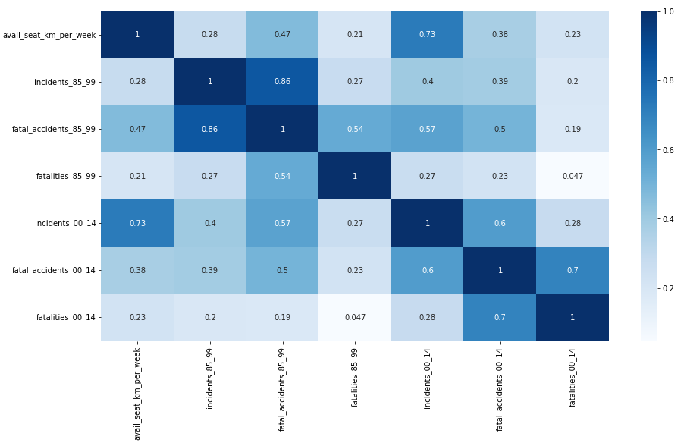
Exploratory Visuals
Correlation heat map was created to visualize the numerical data:
Visually “mapped” the correlation between the numerical features
Apparent multicollinearity esp. between the fatal accidents and fatalities values which makes sense, e.g., fatal accident has fatalities.
Positive correlation bet. avail_seat_km_per_week and a) incidents_00_14 (0.73) and b) fatal_accidents for 1985-99 (0.47) and 2000-14 (0.38).

